Slide 1

WOODEN ENAMEL
INTERIOR DOORS CATALOG

Slide 2

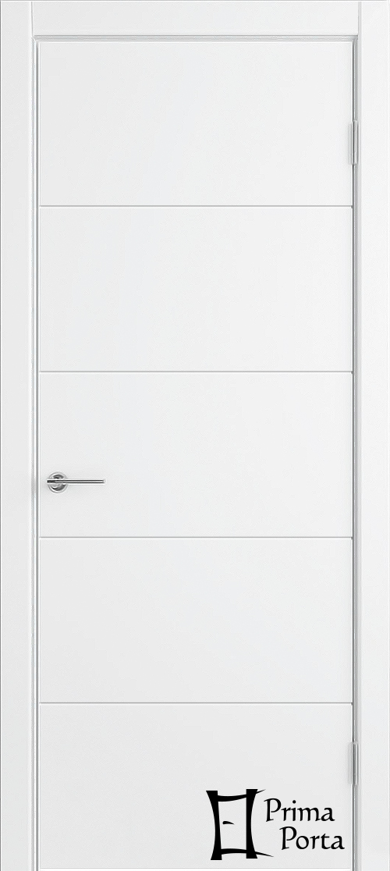
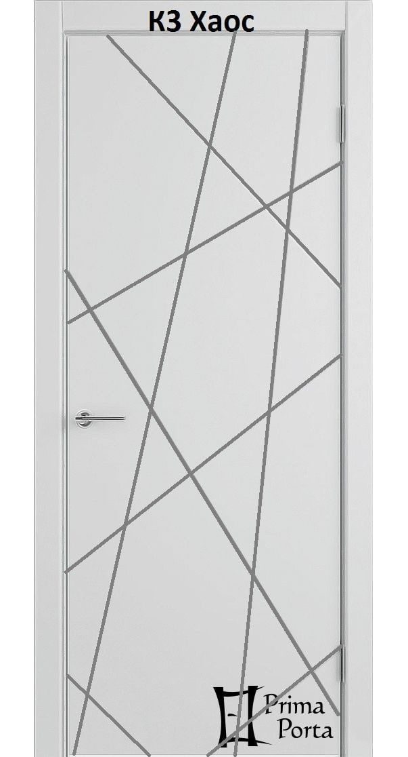
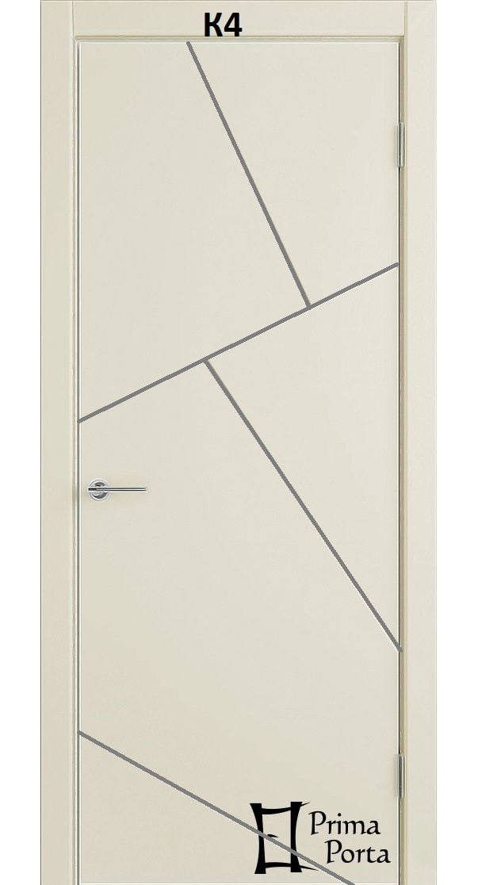
K1
K2
K3
K4

Slide 3
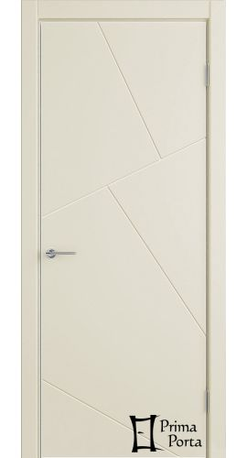


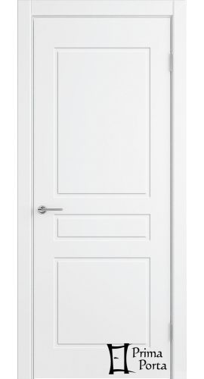
K5
K6
K7
K8

Slide 4
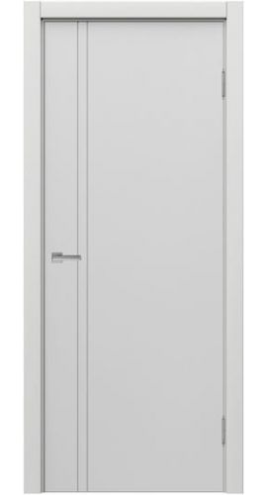
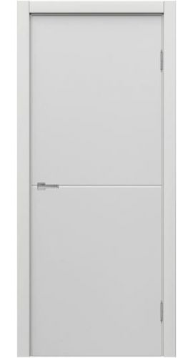
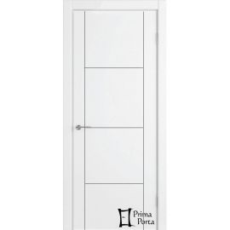
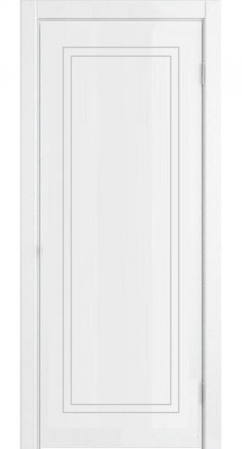
K9
K10
K11
K12

Slide 5
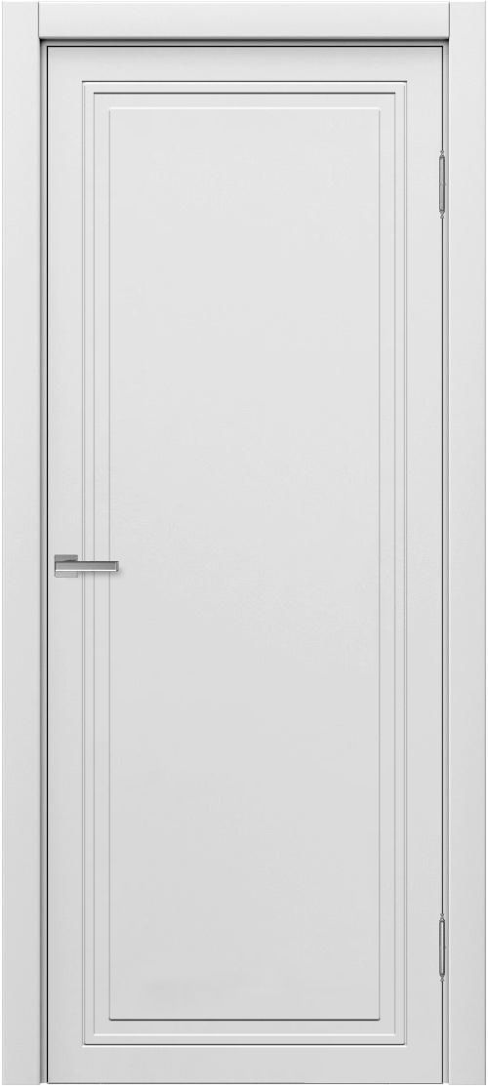
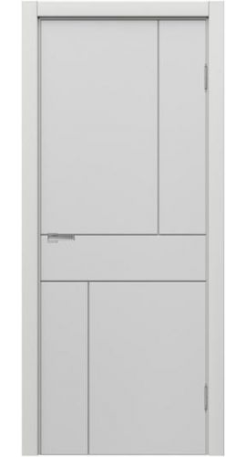

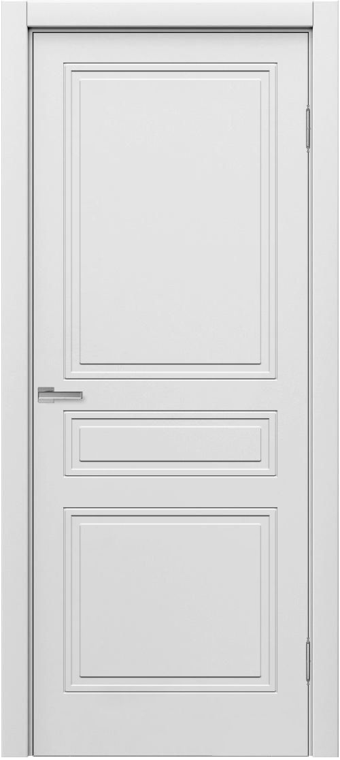
K13
K14
K15
K16

Slide 6
Do you have any questions about the products?
CONTACT US
Phone: +971 56 819 3219, +1 215 464 85 00
E-mail: info@smartgeneraltrade.com
www.smartgeneraltrade.com

